Slide 1
Indigenous (Aboriginal) Health Care in Canada: Engaging First Nations, Métis and Inuit Populations in Building a Renewed Health Accord
Earl Nowgesic, RN, BScN, MHSc, PhD
Assistant Professor
Interim Director, Waakebiness-Bryce Institute for Indigenous Health
Dalla Lana School of Public Health, University of Toronto
Toronto, Ontario
Senate Open Caucus on the New Health Accord
November 16, 2016, Ottawa, Ontario

Slide 2
All My Relations
I am Anishinaabe (Ojibwe) from Kiashke Zaaging Anishinaabek (Gull Bay First Nation) and I have over 20 years of experience working in the health care sector in Canada.
My parents are Ojibwe. Both attended Aboriginal residential schools and, despite the legacy of the Aboriginal Residential School System, they persevered in keeping true to their cultural traditions, ultimately passing these values down to me and my three sisters.
I would like to acknowledge the Algonquin people whose traditional territory we are meeting on today.

Slide 3
Population in Canada
Total 33 million in 2011
  4.3% Aboriginal
  95.7% Non-Aboriginal
Identity population grew from 2006 to 2011
  20.1% Aboriginal
  5.2% Non-Aboriginal
Aboriginal group identity population increased from 2006 to 2011
  22.9% First Nations
  16.3% Métis
  18.1% Inuit
(Statistics Canada, 2013)

Slide 4
Inequities and Disparities
Aboriginal Peoples in Canada face striking and persistent inequities in health determinants, health status and health care compared to the general Canadian population.
There is a growing discrepancy between Aboriginal Peoples and Settler Canadians in disease burden and health outcomes.
Major inquiries such as the Royal Commission on Aboriginal Peoples (1996), the Romanow Commission on the Future of Health Care in Canada (2002), the Kelowna Accord deliberations (2005), and the Truth and Reconciliation Commission of Canada (2015) speak to strategies to eliminate inequities between Aboriginal and non-Aboriginal populations and the resultant disparities for Aboriginal Peoples. However, little progress has been made on these strategies.

Slide 5
Suggestions for Developing a Renewed Health Accord
To develop concrete objectives for the Renewed Health Accord pertaining to Indigenous Peoples (i.e., First Nations, Métis and Inuit).
To strive for innovation and relevance in Indigenous health policy and practice, while supporting Indigenous self-determination.
To identify and support scientifically excellent and community-relevant strategies for improving Indigenous health and wellbeing.
To train health professionals and leaders dedicated to Indigenous issues.
To encourage sustained and robust individual and institutional leadership in Indigenous health. Indigenous leadership and participation in Indigenous health policy, practice and research initiatives have been identified as fundamental cornerstones for moving forward.

Slide 6
Exemplary Practices of Indigenous Community Engagement:
Commitments from the Canadian Institutes of Health Research
To increase the capacity of the Canadian Institutes of Health Research (CIHR) to interact with Indigenous communities in a culturally appropriate manner.
To increase CIHR investments in Indigenous health research to a minimum of 4.6% (proportional to Canada’s Indigenous population) of CIHR’s annual budget and seek to grow these investments.
To hold annual meetings among the CIHR President and the leaders of the Assembly of First Nations, Inuit Tapiriit Kanatami, and the Métis National Council to discuss Indigenous health research priorities.

Slide 7
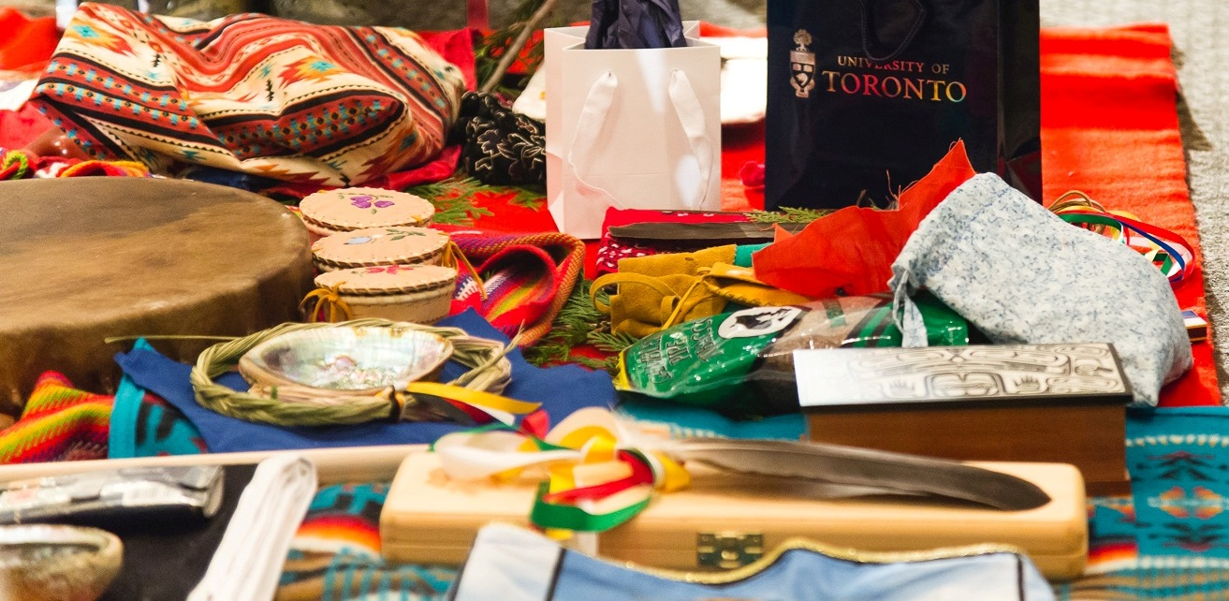
Engage First Nations, Métis and Inuit Populations in the Formation of a Renewed Health Accord

