Slide 1
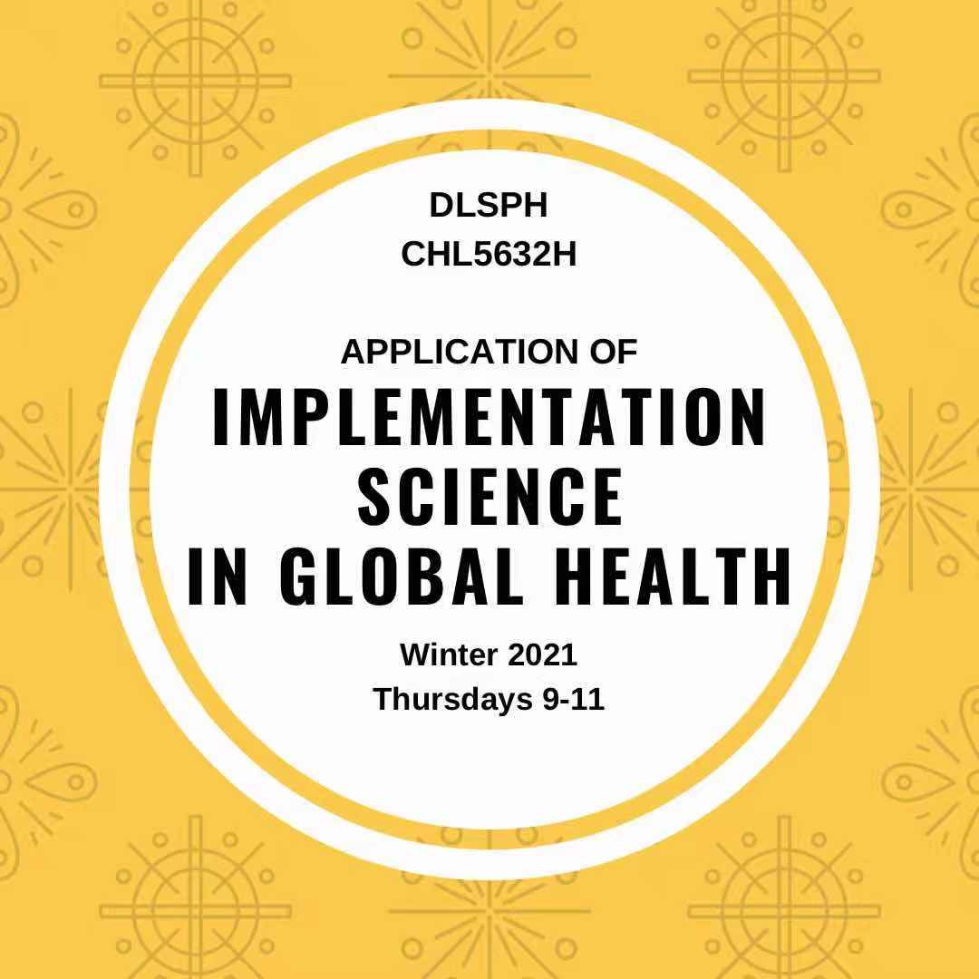
This course aims to review the concept of and recent developments in implementation science; it introduces interdisciplinary theories, frameworks, and research tools to design and evaluate global health interventions, and how to facilitate scale-up research evidence into policy and practice; and explores research tools through case studies to identify and contextualize implementation successes and failures. Specifically, we will discuss how to evaluate and design complex interventions, the application of effectiveness trials and mixed methods studies in evaluating health interventions in global health settings.
Application: This course is intended for 2nd year Master or PhD students in both PHSC and IHPME. Enrollment is limited to 12 students.
Prerequisites: Students should have completed any quantitative or qualitative research methods course; or students have completed at least one course in program evaluation course.
Course director: Prof Xiaolin Wei, xiaolin.wei@utoronto.ca
Student support: Victoria Haldane, v.haldane@mail.utoronto.ca

