Slide 1
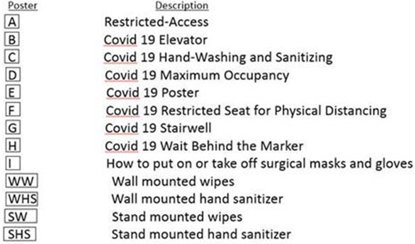


Required – Stand mounted hand sanitizer
Washroom – Knock and Talk
Directional Floor Decal – Indicating Exit
Directional Floor Decal – Indicating Enter

Slide 2
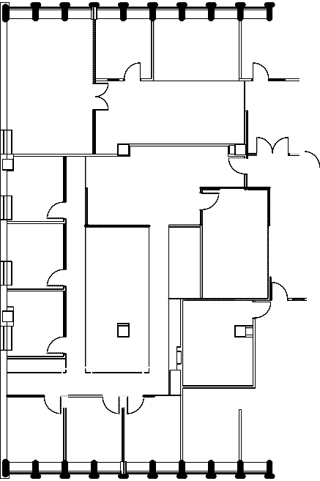






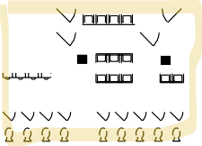

430
438
440
444
448
450
452
425
435K
440K
458A
427
431 433
441
447K
457K
400K
471A
495S
V
491V
491H
491G
491F
491E
488
471S
460E
496K
DN UP ₄₉₅
477
DN UP
493
491
489
487A
460K
UP DN
460B
UP DN
486
460F
460D
497V
475
473
498
475K
460K
484
472
468
466
462

Slide 3
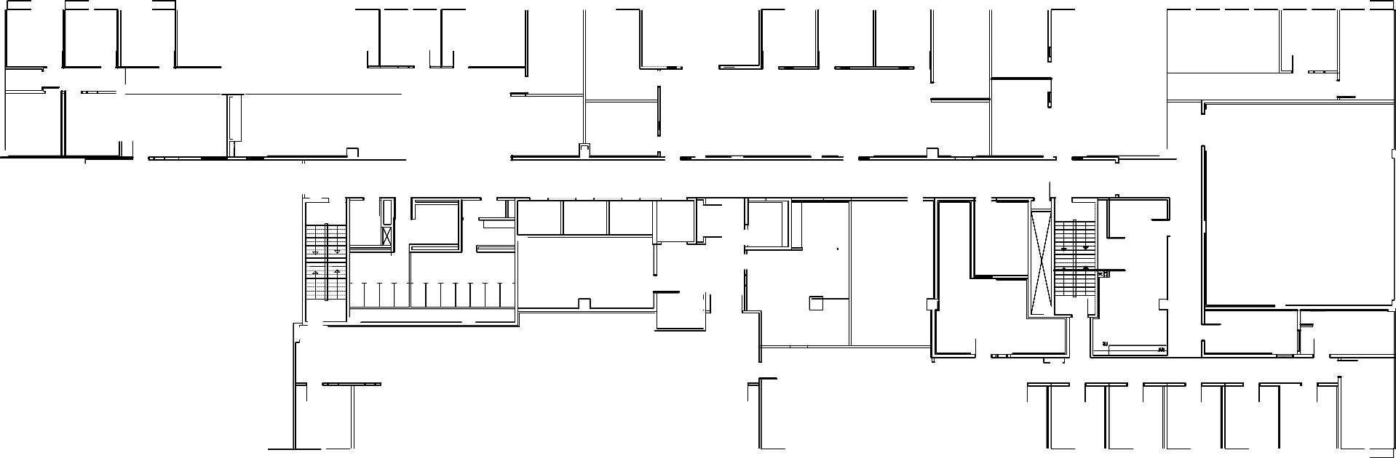



Stairwell – North side access – Entry and Exit
- South Side – Exit only /Card Key Entry
X 3 desks
Stairwell - Exit only
X 3 cubicles
-remove visitor chairs, only 1 person allowed
X 4 cubicles
X 3 cubicles X 2 desks
546C
X 4 cubicles
1 occ
547A
512
1 occ 1 occ
2 occ
528
514
516 518 520
1 occ 1 occ 1 occ
522
2 occ
524
1 occ
526
2 occ
₂532
534 536
1 occ 1 occ
538
1 occ
540 542
1 occ 1 occ
544
2 occ
546B
2 occ
1 occ
3 occ₅₄₇
2 occ
547B
511
508K
Reception:
-plexiglass
-floor markings
521K
rearrange tables
occ
X 5 cubicles
547K
3 occ
508
-remove
4 occ
521
X 7 cubicles
4 occ
4 occ
529
X 8 ppl
2 occ
531
530
7 occ
X 7 Cubicles
546A
546
6 occ
510 509
1 occ 1 occ
523
2 occ
-only one chair
X 8 ppl
1 person at a time
for the table
548 13 occ
ters
sofa chairs
500V
500K
567A
 | 1 occ 500A -remove | 1 occ 500B chairs | 595S DN
^{UP} 595
V 591V
591H
591G
591F
591E
570
Hand soap dispenser
567S
DN UP
-rearrange
507 11 occ
x 16 ppl
567
2 occ
565
549K
monitors in
570A
570K
5 occ
this area
outside
593
591
571
572
569
549
X 12 compu
507B
2 occ
500L
UP DN
570B
6 occ
UP DN
8 occ
Hand soap dispenser
3 occ
500C
550
551
2 occ
573
X 12 Cubicles
6 occ at a time
remove the
wooden chair
X 8 ppl
2 occ
500
14 occ
574
X 35 ppl
561K
507A
6 occ
X 6 cubicles
5 occ at a time
552
2 occ
X 14 cubicles
590
588 586
1 occ 1 occ
584
1 occ
582 580 578
1 occ 1 occ 1 occ
576
566 564 562 560 558
1 occ 1 occ 1 occ 1 occ 1 occ
556 554
1 occ 1 occ
1 occ
1 occ
X 2 desks
Photocopier/Printers
Kitchen/Lunchroom
Washrooms
Faculty /Staff/RA Offices
Storage Area
Student Lockers
U n i v e r s i t y
of Toronto
R e v i s i o n s
1110
Staff/RA Cubicles
DLSPH Classrooms
Mechanical Shaft and Elevators
Health Sciences Building
1911
Double Doors/Entry Doors
Meeting Rooms
ACE Classrooms
Campus & Facilities Planning
Bldg 154
DWG
Computer Lab
PHS Student Study Area
5th Floor
Student Lounge
Meditation Area
0604
6 of 9

Slide 4





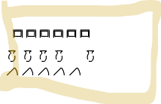



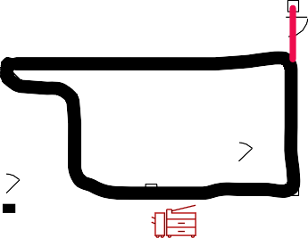
610B
611K
614
618
623
632
634
640
611A
611
610T
606
605K
605
600K
620K
671A
635K
610K
610S
695S
DN UP
692
691H
691G
691F
691E
DN
671S
663
637
610
600V
681
679
694
682B
682
637K
661
X 2 desks
UP DN
UP DN
601K
696
675K
659K
601
2 occ
610A
600
674
664
658
656

Slide 5






Access to both North + South Stairwell
Stairwell – North Side Exit and key only Entry
Washrooms
715
2 occ
720
Hand soap dispenser
726
728
X 40
X 40
X 21 cubicles
744
11 occ
700
V
728
V
734
21 occ
740
21 occ
710T
725
727 1 occ
2 occ
Locker area
793A
770K
4 occ
x 12 Cubicles
9 occ
754
710
OPENTO BELOW
71
1
DN UP
791H
791G
791F
791
E
784
781
778
X 10 seating
DN
700
4 occ
793
1 occ
777
13 occ
790A
786
1 occ
4 occ
759A
787
790K
771S
2 occ
761
795
S
9 occ
776
1 occ
710S
DN
779
771
761A
1 occ
-1 occ for the table in here
25 occ
790
24 – 40 seating
8 occ
788
x16
X 20
-remove chairs in the library
767 + x1 cub
700
8 occ
789
seating
705
1 occ
774
770
1 occ
766
1 occ
764
x12
-remove
772 1 occ
1 occ
762
visitor table
1 occ
Photocopier/Printers
Kitchen/Lunchroom
Washrooms
Faculty /Staff/RA Offices
Storage Area
Student Lockers
Staff/RA Cubicles
DLSPH Classrooms
Mechanical Shaft and Elevators
Meeting Rooms
ACE Classrooms
Double Doors/Entry Doors
Computer Lab
PHS Student Study Area
Student Lounge
Meditation Area

