Slide 1
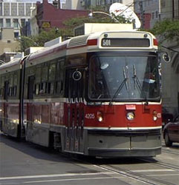
Masters of Public Health in Health Promotion Dalla Lana School of Public Health University of Toronto Lori E. Ross, Ph.D. Program Director

Slide 2

Land Acknowledgement
We would like to acknowledge the traditional territories of the Mississauga of the New Credit First Nation, Anishnawbe, Wendat, Huron, and Haudenosaunee Indigenous Peoples on which the Dalla Lana School of Public Health now stands.

Slide 3
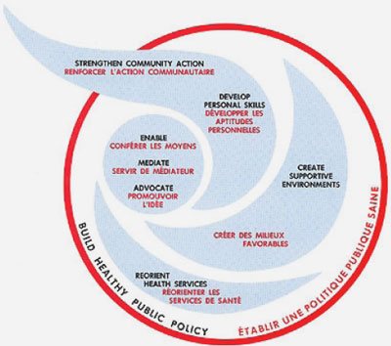
What is health promotion?
Includes competencies in community development, healthy public policy, organizational development, health communications, research and evaluation, social determinants of health, equity and social justice …
Graduates are working as policy analysts, research assistants, HP program developers, evaluators
Graduates are working in gov’t, hospitals, public health, community health centres, private sector +

Slide 4
Why choose an MPH in Health Promotion?
To gain a critical understanding of the range of health promotion theories, approaches and strategies for responding to health-related issues
To learn how to do a situational assessment of individuals and communities grounded in an understanding of the social and political determinants of health and illness
To practice developing, implementing and evaluating health promotion interventions at the individual, community and societal levels
To learn strategies for working effectively across disciplines, across sectors and with members of the public
To develop the research and analytical skills necessary to work as part of a research, policy or practice group

Slide 5

What distinguishes an MPH in Health Promotion from other MPH degrees?
Our critical social science approach
Our focus on the social determinants of health, equity and social justice
The opportunity to develop both qualitative and quantitative research skills
The opportunity to move into a health promotion career in the community, government, or a variety of other sectors

Slide 6
Admission Criteria - 1
GRADES
Undergrad degree with minimum GPA of B+ over last 10 courses (especially courses in your last 2 senior years) but usual grade average is A-/A
SOCIAL SCIENCES
4-6 social sciences courses (e.g. sociology, psychology, anthropology, political science, history, geography, etc. as well as inter/multi-disciplinary approaches such as health studies, women’s studies, etc.)
STATS requirement with minimum grade of B+

Slide 7
Admission Criteria - 2
LETTER OF INTENT
needs to be well written and show a strong understanding of social determinants of health
EXPERIENCE/CV
paid and volunteer experience in public health and community settings; research experience
LETTERS OF REFERENCE
2 letters of reference – ideally from an academic reference and a volunteer or work supervisor

Slide 8

Program Timeline
Note 1: Part-time students are on a different trajectory.
Note 2: The maximum FCE allowed for fees paid is 11.0
Note 3: Find this online here: https://www.dlsph.utoronto.ca/program/mph-social-and-behavioural-health-sciences-health-promotion/ (under “Program Requirements”)
YEAR | FALL | WINTER | SPRING/SUMMER
Year 1 | (2.5 FCE) Introduction to Public Health Sciences CHL5004HY Health Promotion 1 CHL5103HF Social Determinants of Health CHL5105HF Epidemiologic Methods 1 CHL5401HF Biostatistics 1 CHL5201H | (2.0-2.5 FCE) Health Promotion 2 CHL5104HS Theory and Practice of Program Evaluation CHL5110HS Intro to Qualitative Methods CHL5107HS Plus 1-2 approved electives | (2.0 FCE) PRACTICUM I: Required practicum placement with a relevant agency A 16 week (2.0 FCE) practicum is recommended A 12 week (1.5 FCE) practicum is also permitted
Year 2 | (2.0 FCE) Public Health Policy CHL 5300HF One approved advanced research course Two approved electives | (1.5-2.0 FCE) Any combination of the following: ▫ 8-12 week Practicum II** ▫ Approved electives ▫ Or any combination of practicum and electives equaling 1.5 - 2.0 FCE **the maximum amount of practicum credits is 3.5; as such the maximum length of the second practicum depends on the length of the first | GRADUATION!!!!

Slide 9

Program Opportunities
TWO practicum opportunities – applying theory to practice, policy, and research
Almost 900 faculty members with a broad range of expertise
Unique critical social sciences approach

Slide 10
Important Dates
Applications open Oct 15, 2025
DEADLINE – January 16, 2025
Decisions will be communicated in April 2026
Start at beginning of September 2026

Slide 11

FAQs
Are there funding opportunities available?
Students are primarily required to self-fund (and Toronto is an expensive city to live in)
For information about the limited available funding opportunities, visit: https://www.dlsph.utoronto.ca/gdphs-handbook/student-awards-and-funding-opportunities/

Slide 12
FAQs
How do I know whether my statistics course meets the requirements?
Must be taken at an accredited university (i.e., not Coursera)
Must include all the topics listed here: https://www.dlsph.utoronto.ca/students/future-students/application-process/statistics-requirements-for-mph-by-field/

Slide 13
FAQs
Can I meet with you to ask more questions or get feedback on my suitability?
Unable to meet with all prospective applicants or give feedback on applications
Feel free to email me with admissions-related questions: l.ross@utoronto.ca

Slide 14

Questions?

